Slide 1
SE Workshop: GitHub

Slide 2
Sommaire
What is GitHub?
How to use GitHub
Practical Workshop
Notes:
probably cant do eng, to i hope we can

Slide 3
GitHub: What is GitHub

Slide 4




General info
Founded: 08/02/2008
Launched: 10/04/2008
Chris Wanstrath
PJ Hyett
scott chacon
Notes:
github is: GitHub, Inc. is a provider of Internet hosting for software development and version control using Git. It was founded on February 8 2008 as Logical Awesome LLC and launched on the 10th of April on the same year. That was 13 years ago.
The website was developed by Tom Preston-Werner, Chris Wanstrath, P. J. Hyett and Scott Chacon
It currently works on almost all plateforms, originally a website, it now has a desktop version and an mobile version as well.
https://en.wikipedia.org/wiki/GitHub
https://octoverse.github.com/

Slide 5
Some Stats
65 M+
Developers
200 M+
Repositories
1.9 B+
Contributions last year
Notes:
Heres a real quick presentation of the recent github stats.

Slide 6
Features
Share repositories online and publish your projects to the public
collaborate with your teammates
contribute to open source projects
Serves as social media platform for developers
Notes:
Basically, it’s hosted Git, it allows you to share repositories online, publish projects to the public, collaborate on open source projects or with your teammates. It can also serve as a social media platform, but for developers, because it allows you to follow developers or favourite their works.

Slide 7


Git vs. GitHub
The main technology
Version control system
using CLI
The platform where you share and collaborate using Git
used on the Web

Slide 8
GitHub: How to use it

Slide 9
Main Functionalities
Starting-up and using repositories
- Creating a new GitHub repository
- Pushing our code to the GitHub repository
- Making changes to the GitHub repository
- Cloning an existing GitHub repository
Collaborating on a project
- Pushing a branch to GitHub
- Creating a Pull Request (PR)
- Pull changes from GitHub
Contributing to other open source projects
- Forking a repository
- Working with a forked repository on your local machine
- Proposing changes to the original project
Notes:
Starting-up and using repositories
- Creating a new GitHub repository
- Pushing our code to the GitHub repository
- Making changes to the GitHub repository
- Cloning an existing GitHub repository
Collaborating on a project
- Pushing a branch to GitHub
- Creating a Pull Request (PR)
- Pull changes from GitHub
Contributing to other open source projects
- Forking a repository
- Working with a forked repository on your local machine
- Proposing changes to the original project

Slide 10
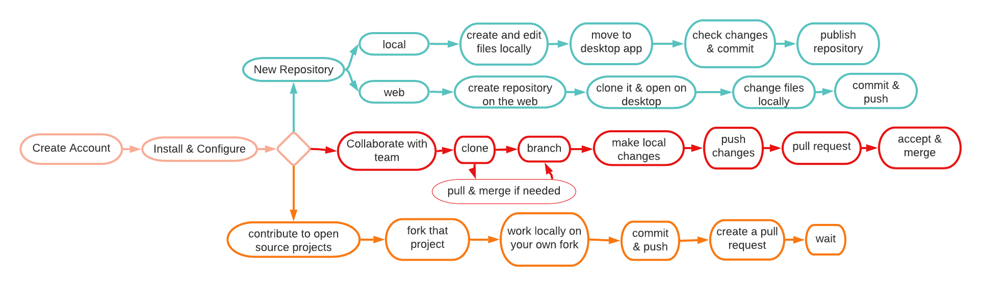
Basic Workflow
Notes:
as working on with github for the first time can get very confusing, i tried to draw up a flowchart to explain the basic functionalities github offers with the desktop app, and how to use them.

Slide 11


Account Creation
Notes:
You can’t use the web version of GitHub without creating an account first, so please follow me as i show you the instructions to do so

Slide 12
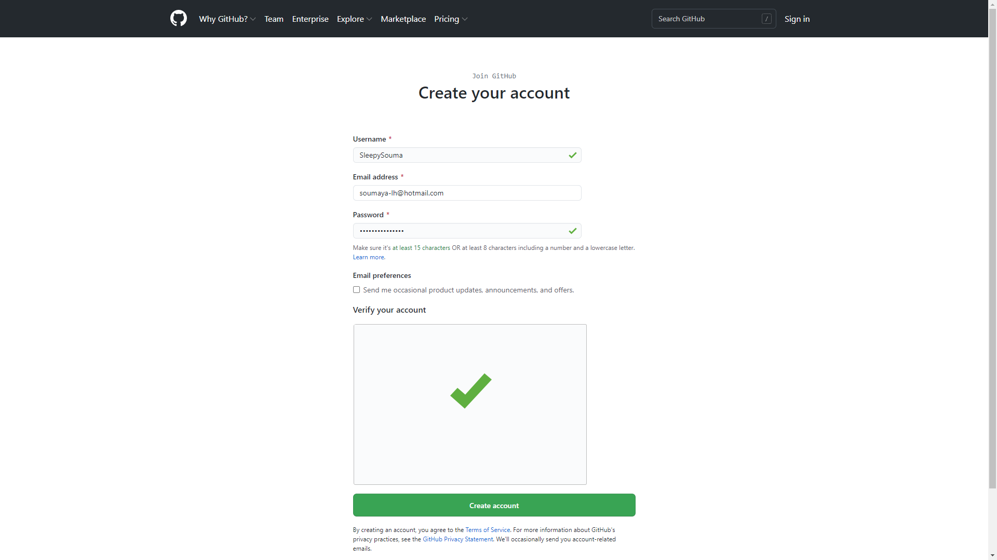

Slide 13
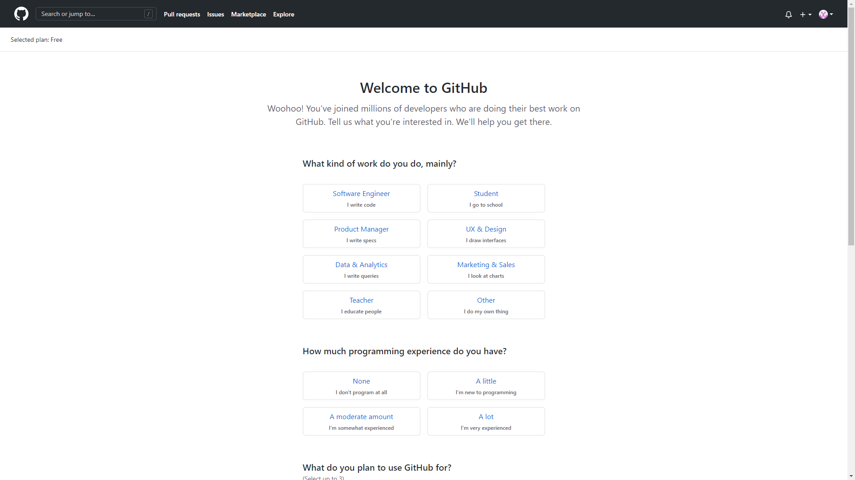

Slide 14
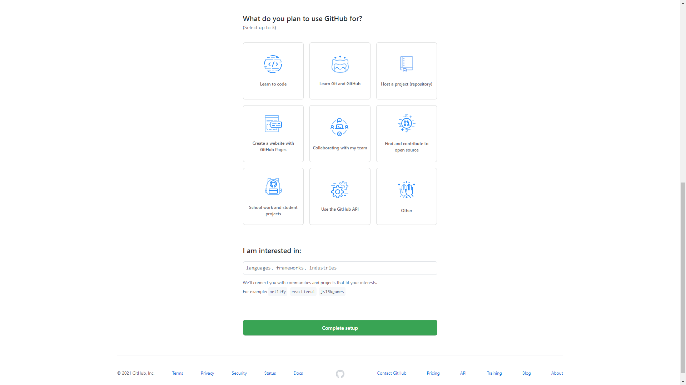

Slide 15
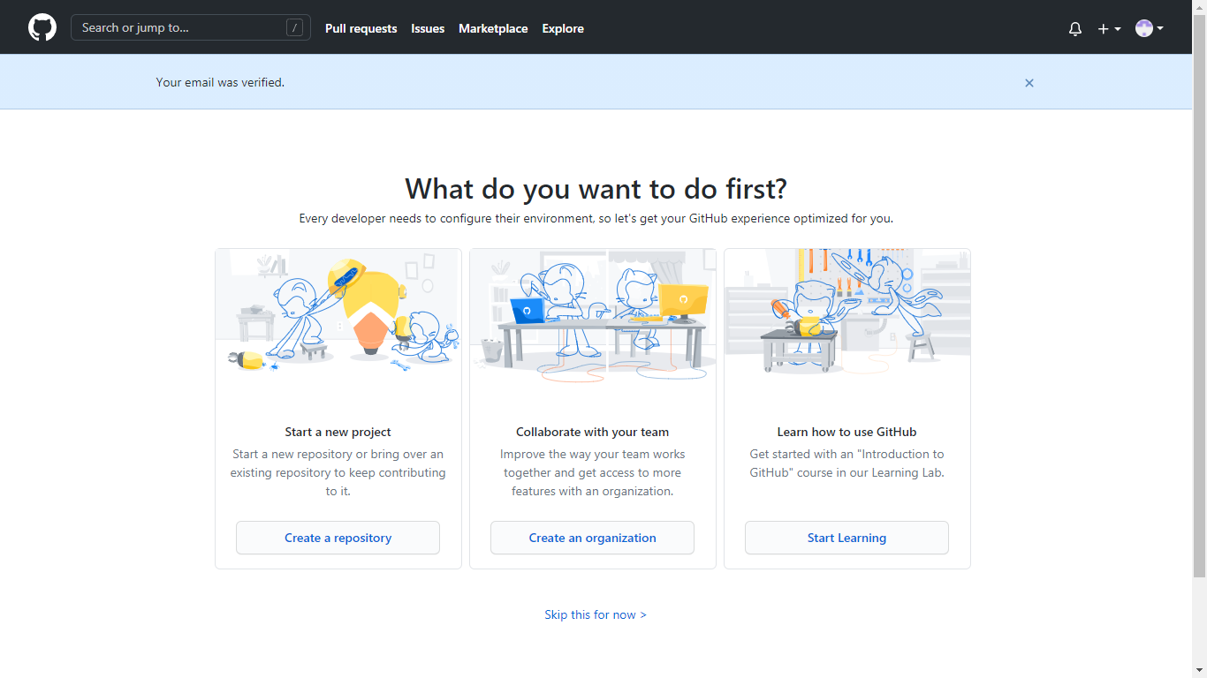

Slide 16
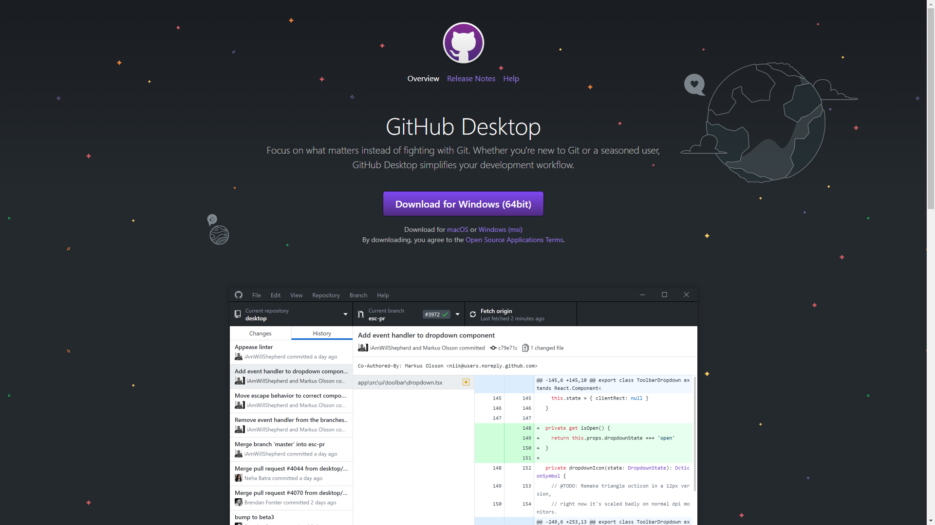
Installation et Configuration
pic here
links here

Slide 17
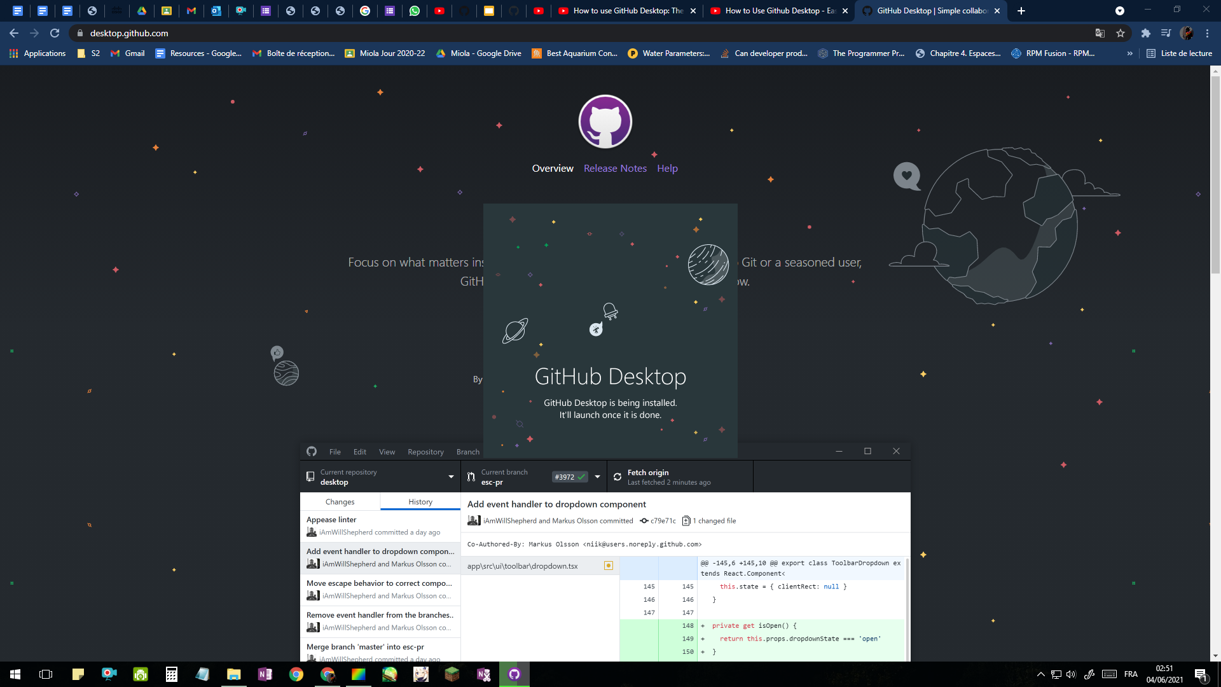
screenies

Slide 18
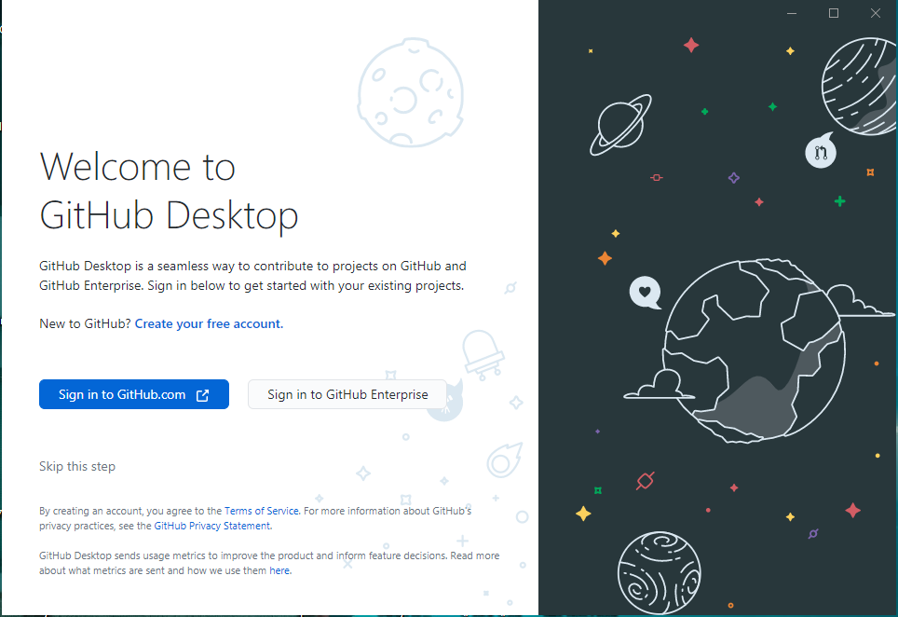

Slide 19
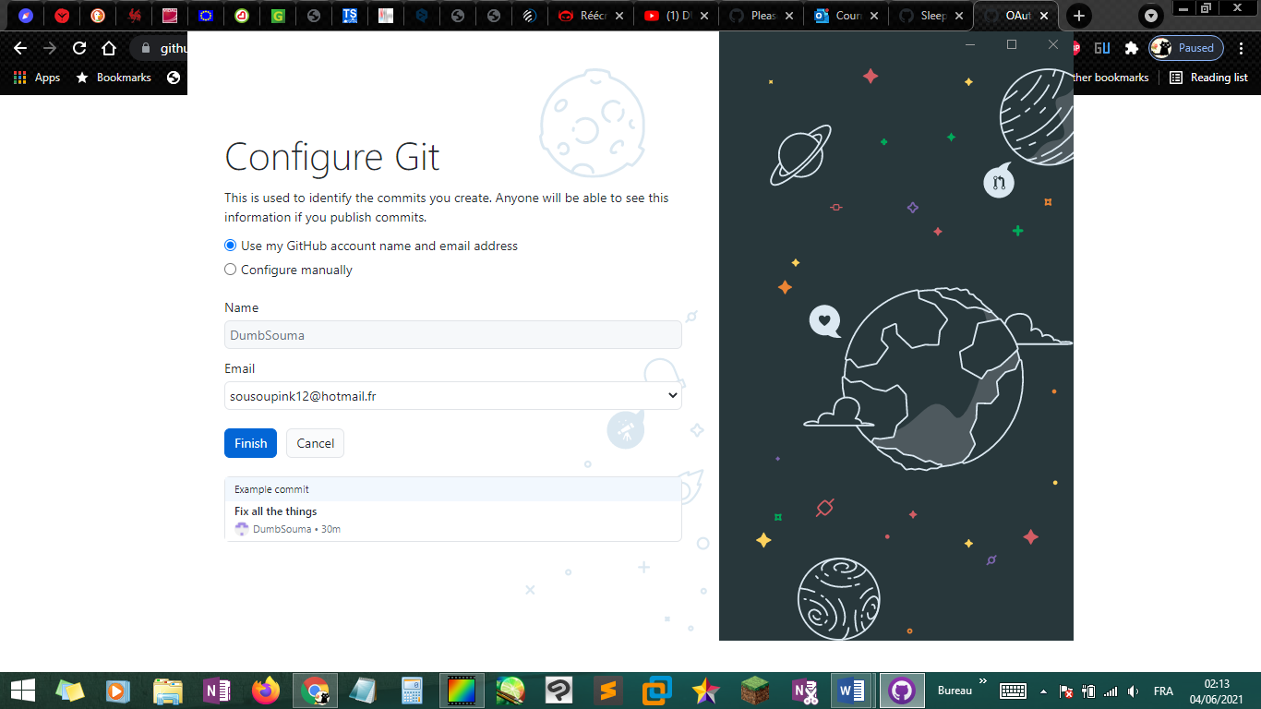

Slide 20
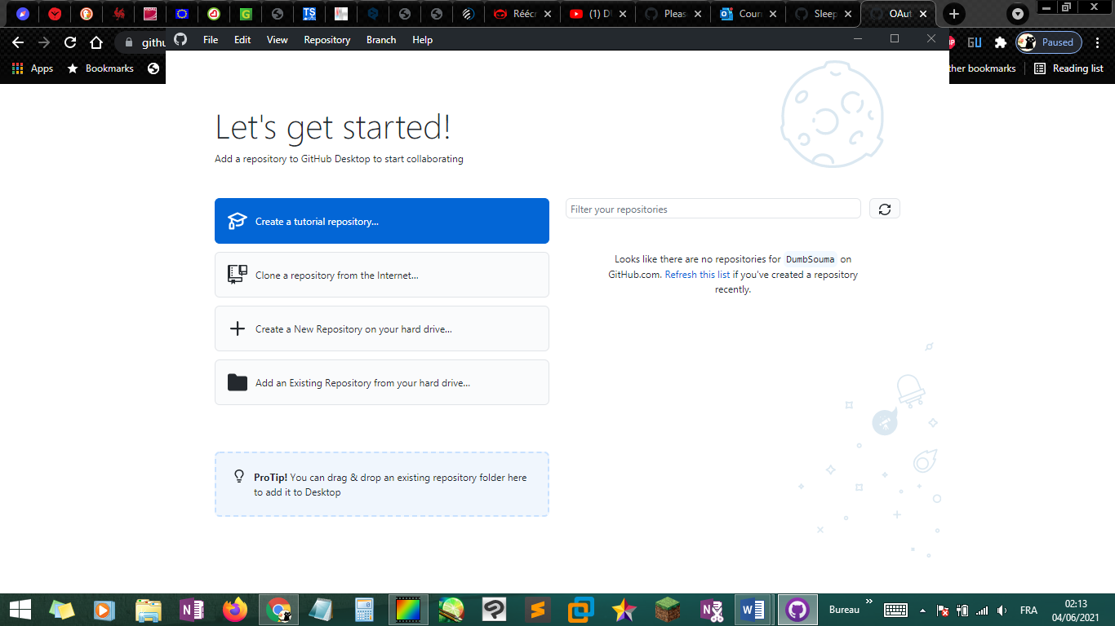
Notes:
from here you can start by either creating a new repository, add an existing one or clone one from the internet.

Slide 21
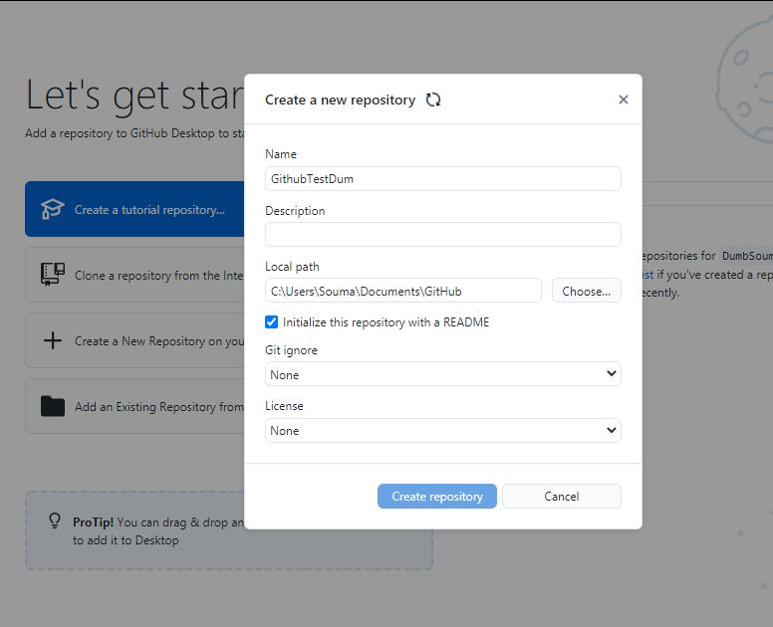
Demo: Guided Tour
Github Web & Desktop Interface
Adding a local repository
Forking a Github project
Notes:
I will now share my screen as I introduce the interface of the github desktop app and

Slide 22
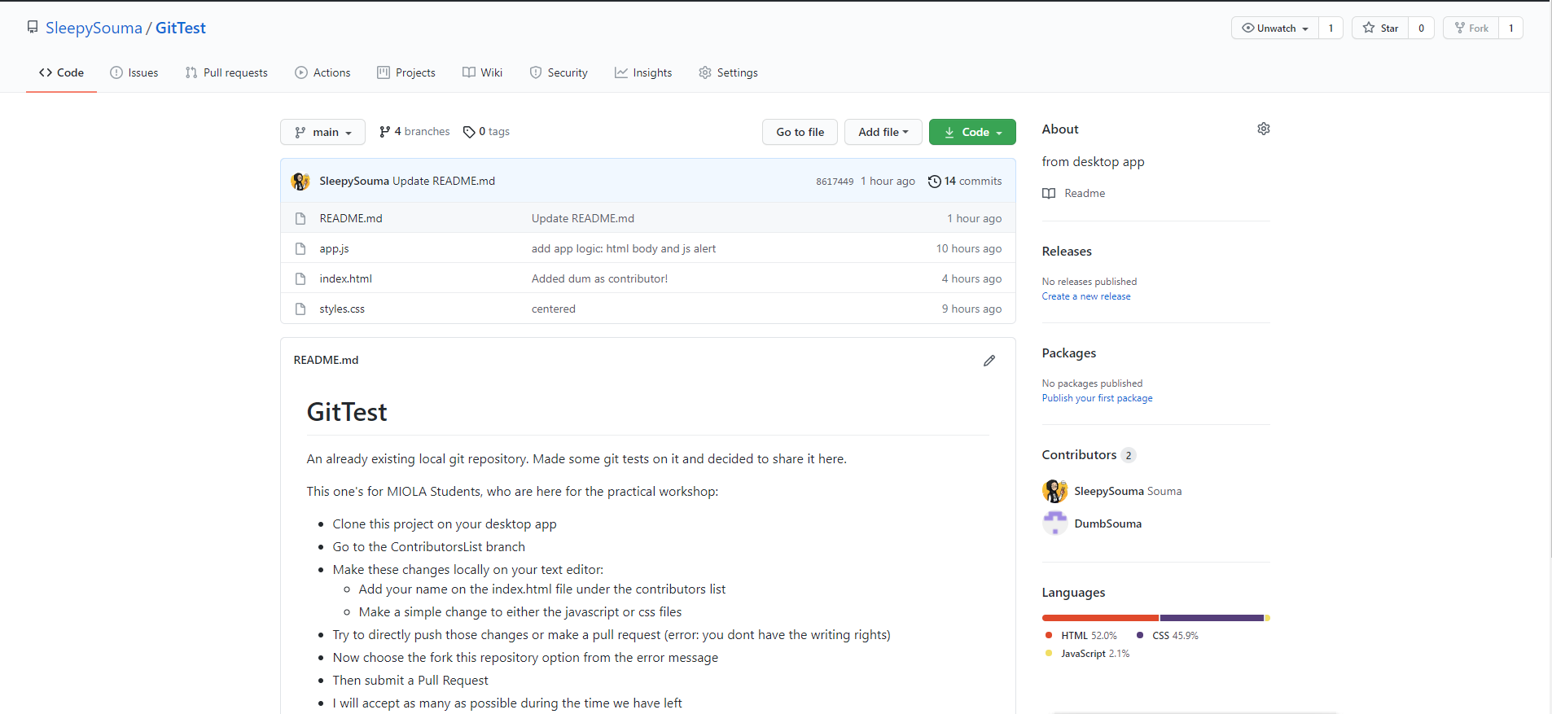
GitHub: Practical Workshop
Notes:
For the practical workshop, i would like to ask you all to head to my GitHub GitTest project, and read up the instructions on the readme file on the front page, as i will demonstrate in a bit.
I would like for you all to follow on your own computers

